Slide 1

Project Title - AI-Based Network Intrusion Detection System
Student Name : Shreyas Hiru Vanage
AICTE ID : STU6431c64cd99281680983628
Apply ID : APPLY_17631451196917759f94642

Slide 2

PROBLEM STATEMENT
Modern networks are prone to several cyber threats that traditional security systems cannot cope with effectively. The given project presents the requirement for an intelligent intrusion detection system using machine learning techniques for the classification of network traffic and AI-based explanation techniques, which provide insights into the detection results, making them understandable and actionable.

Slide 3
Project Description
In this project, a network intrusion detection system is developed through the application of AI and a Random Forest classifier that identifies malicious events for network traffic. The project combines an AI explanations component and a streamlit dashboard that permits interpretable and interactive results for network intrusion detection.

Slide 4

WHO ARE THE END USERS?
Cybersecurity students
Network security analysts
System and network administrators
Academic institutions / training centers
Cybersecurity researchers

Slide 5

Technology Used
Python
Machine Learning (Random Forest Algorithm)
Streamlit (Web Interface)
Scikit-learn
Pandas & NumPy
Groq API (AI Explanation)
CSV-based Network Traffic Dataset (CICIDS)

Slide 6
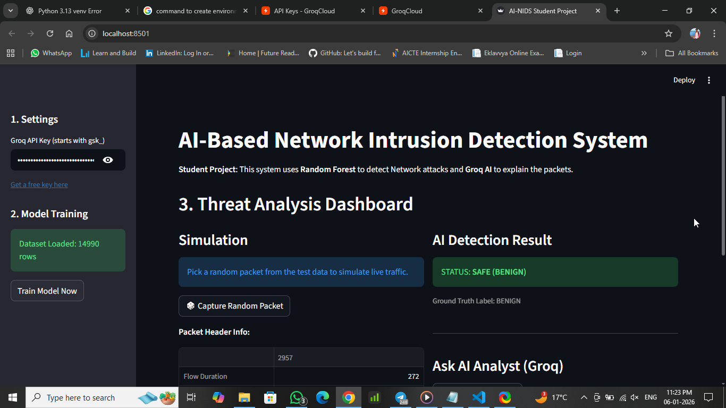
RESULTS
Demo Link

Slide 7
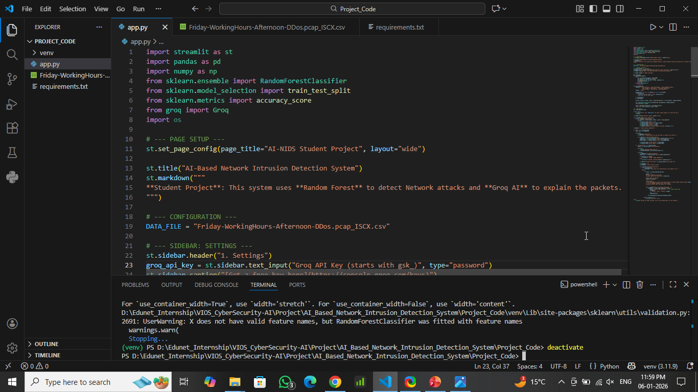
RESULTS
Demo Link

Slide 8


Slide 9

Certificate - Protection from browser attacks

Slide 10

Certificate - Introduction to System Security

Slide 11

Certificate - Securing Android Devices

Slide 12
GitHub link
https://github.com/Shreyas-Vanage/AI_Based_Network_Intrusion_Detection_System__VOIS_CS_AI

Slide 13
Thank you
.

